Slide 1

Smart
Switch
Course: EE Independent Project (EE 171)
Instructor: Dr. Rinkee Chopra
Mid-Evaluation Term
Date : 01/03/2023

Slide 2
Group Members
Anuj Gupta(12240210)
Ankit Arya(12240180)
Prince Patidar(12241360)
Yenneti Nitin Sree Venkat (12242060)
Faculty Advisor: Dr. Arzad Alam Kherani

Slide 3

Introduction
It’s always been a burdensome task when you are all set and ready to start your work and forget to turn on the fan, light, or other appliances. We always think that there should be some magic that will turn on/off your devices without doing any physical work.
Therefore our project is to create a wirelessly controlled switchboard that will be operated via a mobile application.
We can connect this switchboard to the home circuit system. This device will convert all your appliances into smart devices right under your fingertips.
Main features:
Easy to operate with mobile
No use of any remotes
Reduces strain of switching on/off of appliances
Fast and Accurate response
Provides better safety

Slide 4
Components and Requirements
Arduino Uno -1
Bluetooth Module (JDY-31 for Arduino ) -1
Relay Module(HW-315 5V 10A 4 Channel Relay Module) -1
Jumper wires
AC Bulb and Bulb Holder -1 each
AC power source
Cardboard

Slide 5
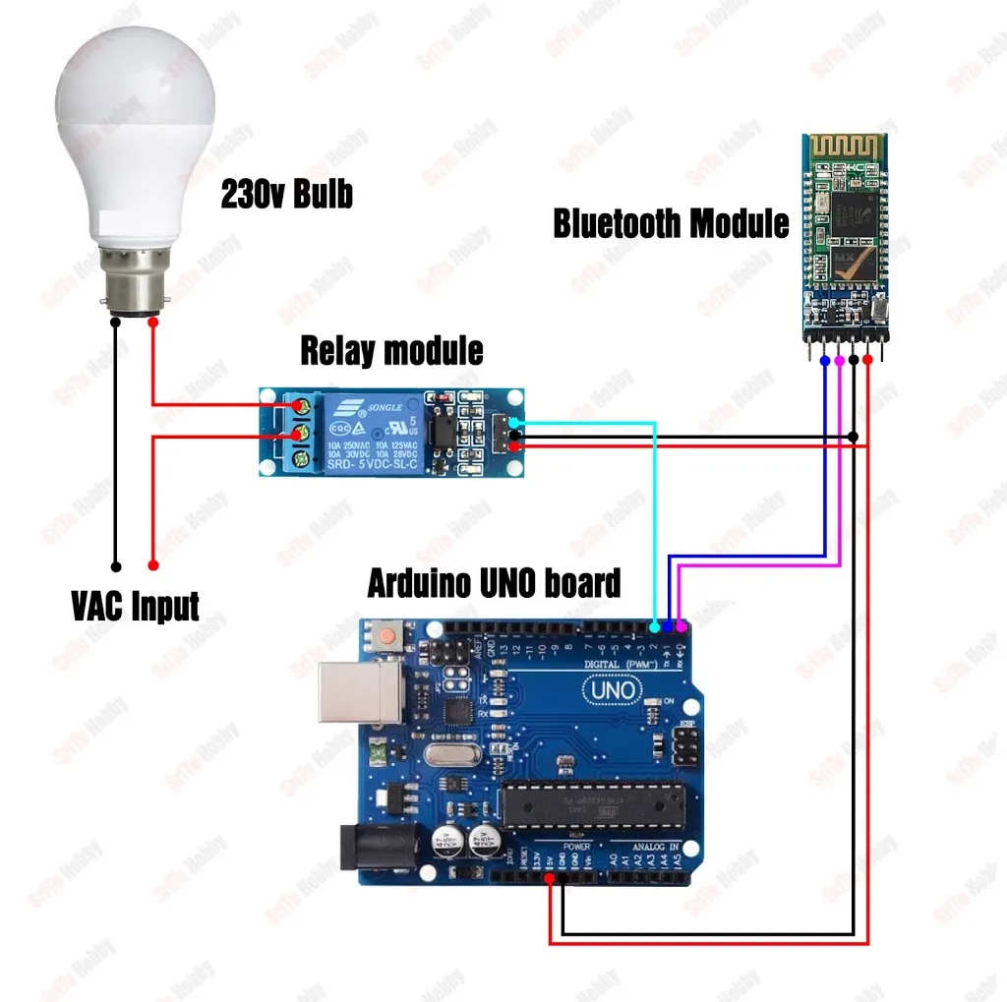
Circuit Diagram :

Slide 6





Working
Arduino UNO
An Arduino is a microcontroller board, which is essentially an entire computer on a chip. It has a processing core, memory, and input and output controls all in one chip. This is the heart of the project. We have programmed and connected it so that it receives the signal via the Bluetooth module and turns on the relay module, which turns on the bulb/appliance.
This Photo by Unknown Author is licensed under CC BY-SA

Slide 7
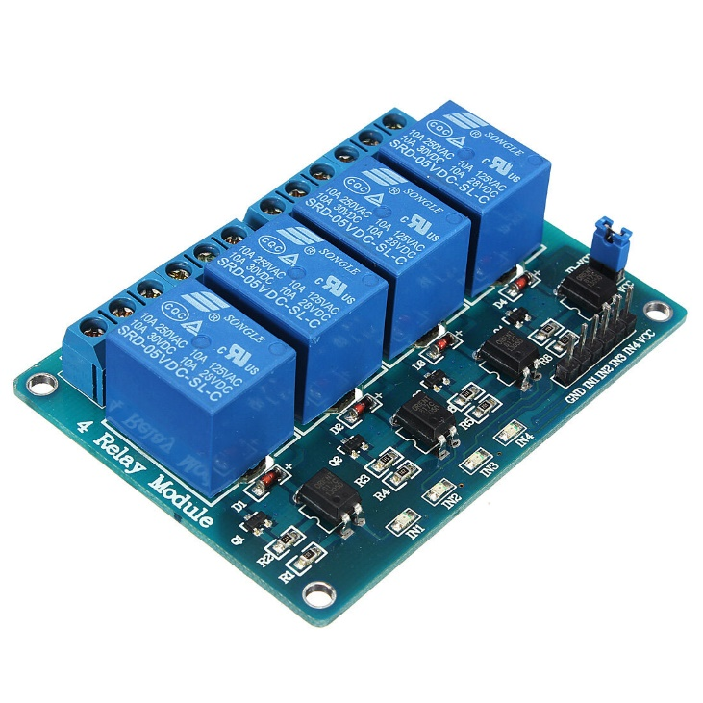
Relay Module
A relay is an electrical switch that can be used to control devices and systems that use higher voltages. Essentially, relay module works on the mechanism of an electromagnet. We use it as a switch here in our project. When the Arduino sends the signal to the relay module, the electromagnet turns on and connects the secondary circuit.

Slide 8
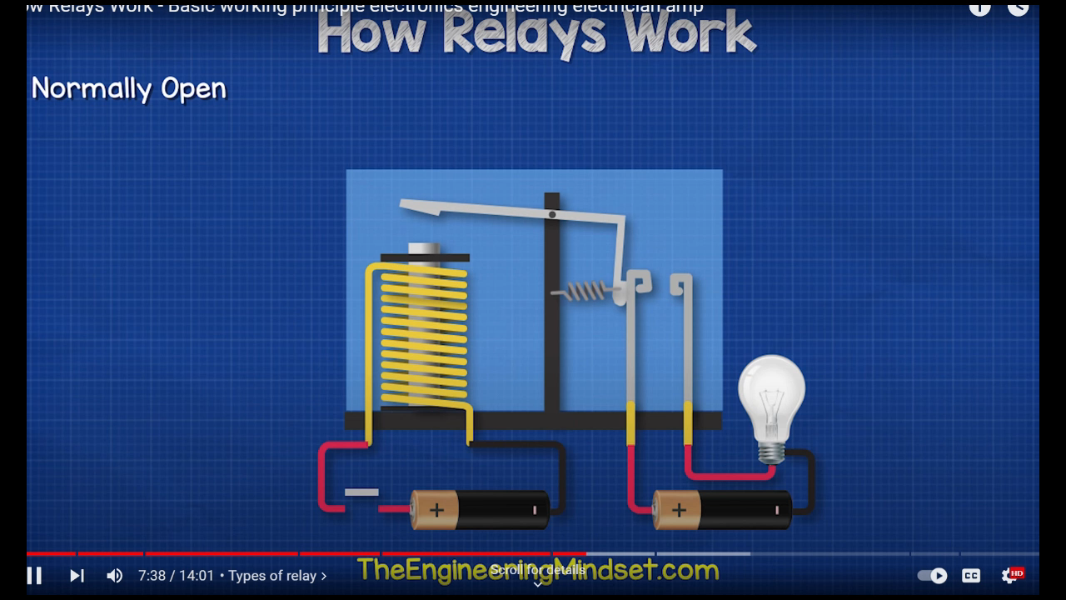

Slide 9
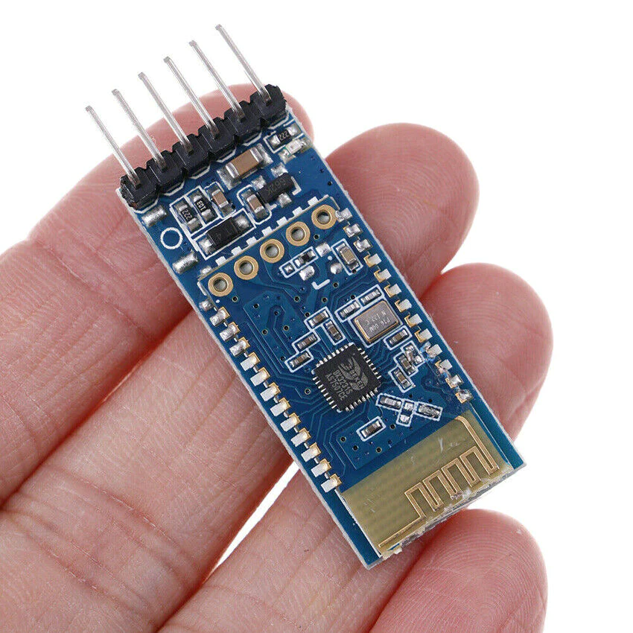
Bluetooth Module
A Bluetooth module is a device that uses radio waves to wirelessly connect two or more electronic devices. Bluetooth modules typically use very little power, making them ideal for portable electronic devices. We are using Bluetooth as our communication medium between mobile and Arduino board.

Slide 10
References
https://srituhobby.com/how-to-make-a-bluetooth-control-lamp-step-by-step-instructions/
https://youtu.be/1IVLvss5Wm0

Slide 11
Thank you

